Slide 1
Features for molecular structures

Slide 2
What are a features/descriptors ?
A list of Cartesian coordinates is an example of a simple features:
x y z
12.48 12.22 0.
16.48 10.93 0.
15.41 10.00 0.
16.21 12.29 0.
14.87 12.76 0.
14.55 14.15 0.
12.21 13.54 0.
13.23 14.53 0.
13.80 11.82 0.
14.10 10.42 0.
17.50 10.57 0.
15.64 8.93 0.
17.03 13.01 0.
15.35 14.89 0.
11.16 13.83 0.
12.94 15.58 0.
13.29 9.70 0.
A descriptor is a mathematical representation of an object, commonly composed of a list of features that can be used to identify the object.
x

Slide 3
Learning from a poor feature
Here are two examples of DFT energies learned with kernel ridge regression using two different features
Model learned with Cartesian coordinates used as feature
Model learned with a more advanced feature (Oganov’s fingerprint feature)

Slide 4
What make good features ?
A good feature essentially only need to conform to two properties:
Objects with similar properties should have similar features.
The features should be bijective with respect to the objects.
A third property is also desirable, but is not essential:
The list of features should be as compact as possible.
For molecular features 2. can be subdivided into five issues most features attempts to deal with
Features should be invariant under translation.
Features should be invariant under rotation.
Features should be invariant under permutation of identical atoms
A features should be unique to a structure
A structure should only produce one possible feature list
=
=

Slide 5
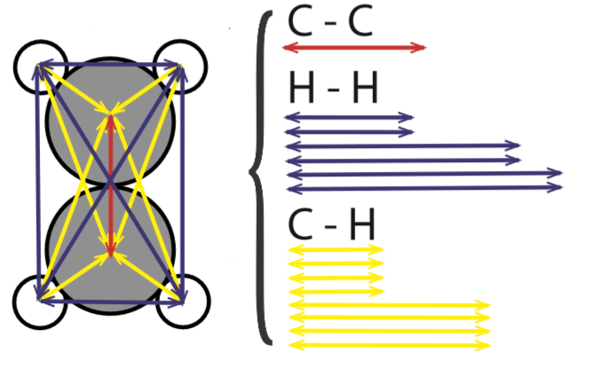
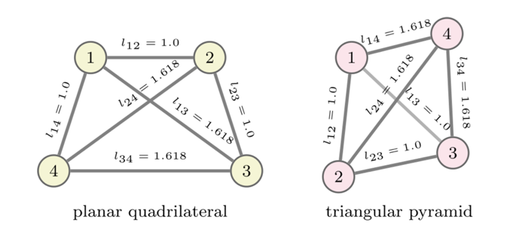
Popular features – Bag of bonds
The bag of bonds feature is constructed from a list of all interatomic distances in a structure.
These distances are grouped according to the atomic types involved and sorted.
Invariant to rotation
Invariant to translation
Invariant to permutation
Not unique
Non-degenerate

Slide 6
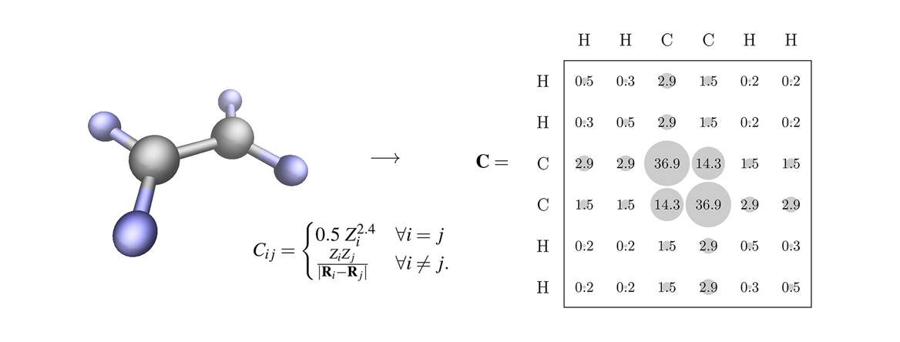
Popular features – Coulomb matrix
The coulomb matrix is constructed by filling a matrix with the bond lengths between atoms matched by the indices of the matrix column and row.
Invariant to rotation
Invariant to translation
Not Invariant to permutation
Unique
Degenerate

Slide 7
Popular features – Fingerprint function
Oganov’s fingerprint function is constructed from a set of radial distribution functions. It can both be made atomic or for the entire structure.
Invariant to rotation
Invariant to translation
Invariant to permutation
Not unique
Non-degenerate

Slide 8
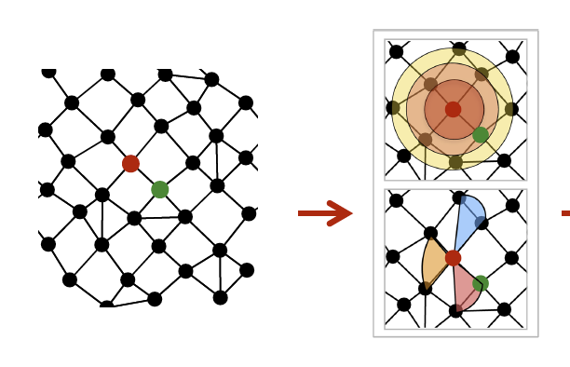
Popular features – Symmetry functions
Behler’s symmetry functions have become a common standard for molecular features. The features are constructed from bond lengths and angles between atoms.
Invariant to rotation
Invariant to translation
Invariant to permutation
Most likely not unique
Non-degenerate
Atomic feature

Slide 9

Knuds feature
Oganov’s fingerprint function is constructed from a set of radial distribution functions. It can both be made atomic or for the entire structure.
Invariant to rotation
Invariant to translation
Invariant to permutation
Not unique
Non-degenerate
$$F_{a}=\sum_{i}{e^{−r_{a,i}}}$$

Slide 10
Knuds feature
Oganov’s fingerprint function is constructed from a set of radial distribution functions. It can both be made atomic or for the entire structure.
Invariant to rotation
Invariant to translation
Invariant to permutation
Not unique
Non-degenerate
$$F_{a}=\sum_{i}{e^{−r_{a,i}}}$$

Slide 11
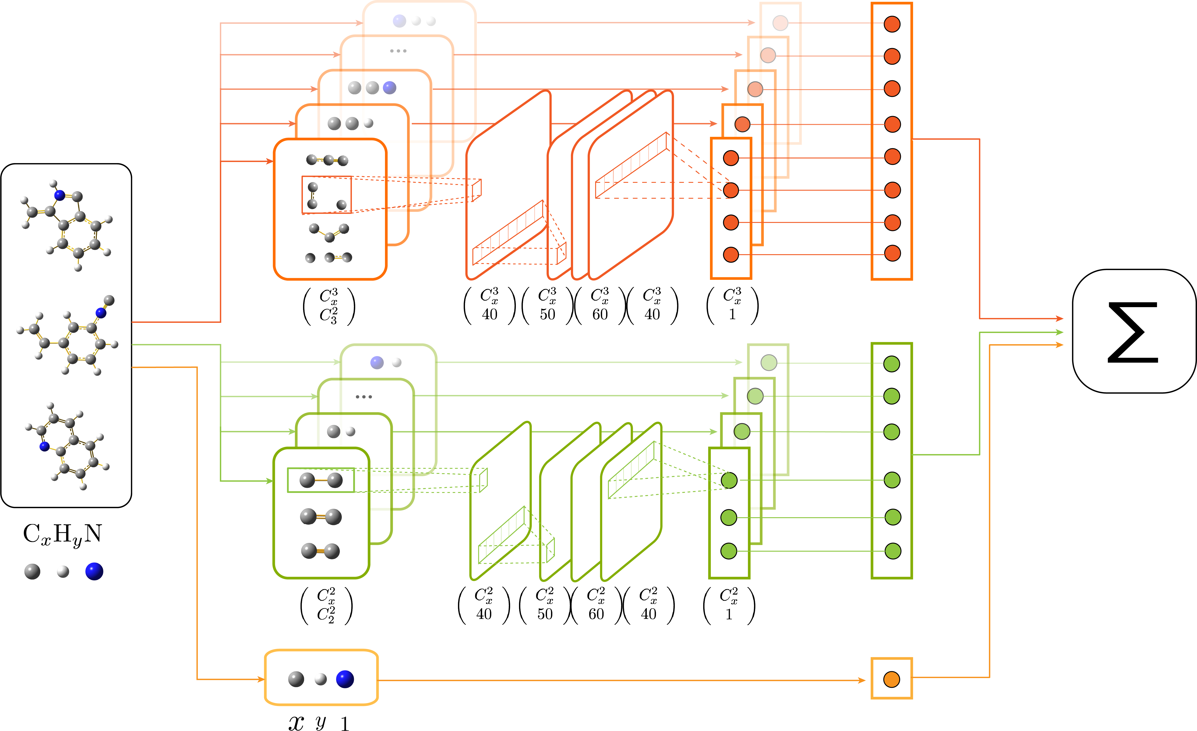

Chens feature
Behler’s symmetry functions have become a common standard for molecular features. The features are constructed from bond lengths and angles between atoms.
Invariant to rotation
Invariant to translation
Invariant to permutation
Most likely not unique
Non-degenerate
$$3body: \left[e^{−\frac{r_{i}}{r_{a}}}, e^{−\frac{r_{j}}{r_{b}}},e^{−\frac{r_{k}}{r_{c}}}\right] \\ 2body: \left[e^{−\frac{r_{i}}{r_{a}}},e^{−\frac{r_{i}}{r_{b}}} \right] \\ 1body: N_{a}$$

Slide 12
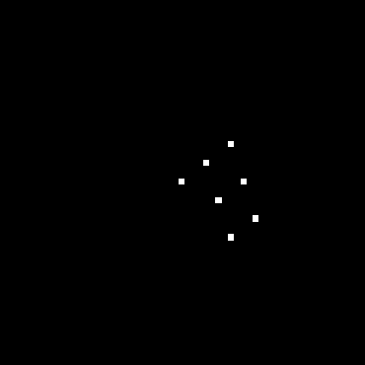
Thomas feature
Oganov’s fingerprint function is constructed from a set of radial distribution functions. It can both be made atomic or for the entire structure.
Not invariant to rotation
Invariant to translation
Invariant to permutation
Unique
Degenerate
1 for atom 0 if no atom. Different atoms have different colors

Slide 13
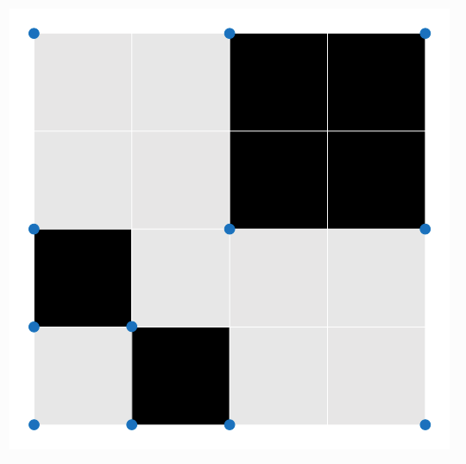
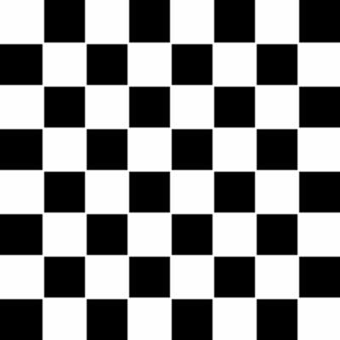
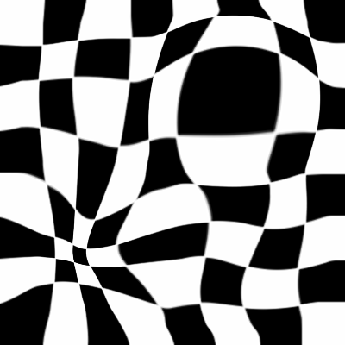


Comparing features
Obtain more data to decrease error
$$error ∝l$$
$$l\left(x\right)=l_{0}2^{−x}$$
$$N\left(x\right)=N_{0}c^{x}$$
Two equations with three unknowns
$$l\left(N\right)=l_{0}N_{0}^{\log_{c}{2}}N^{−\log_{c}{2}}=bN^{a}$$
$a$ is generally constant for a specific set of structures.
$b$ depends on the quality of the features used.

Slide 14
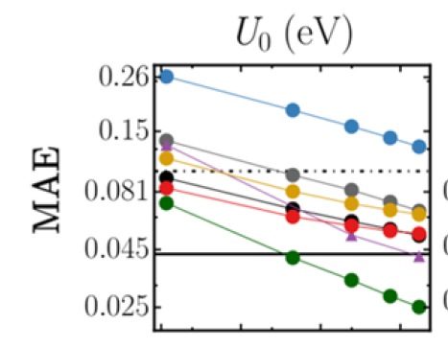
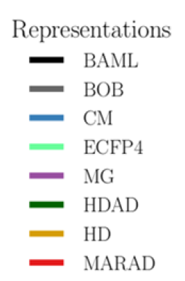
Comparing features – Learning curves
Log-log plots are commonly used for easy comparison between features.
A non linear function in the plot indicates non-uniqueness.
F. A. Faber et al., J. Chem Theory Comput. 13(11), 5255 (2017)

Slide 15
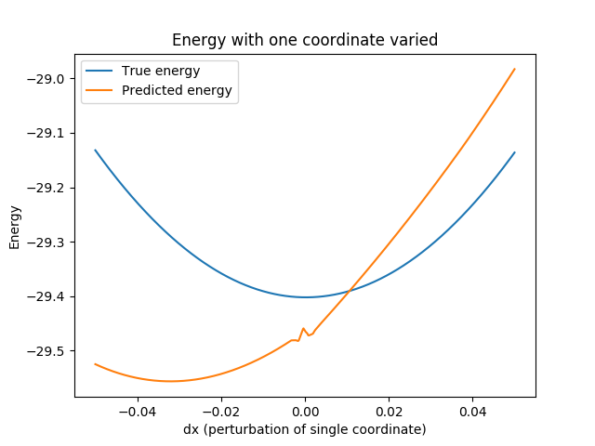
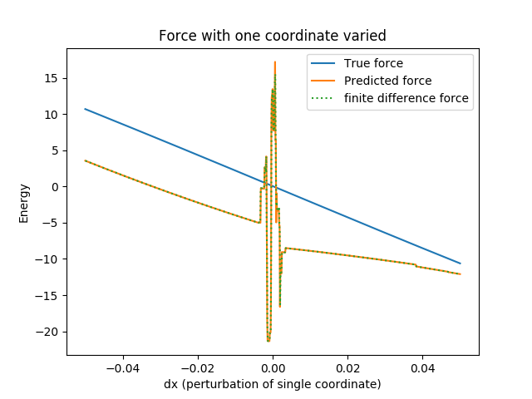
Learning forces – problem with sorted features
1
2
1
2
The derivatives are discontinues!
Bag of bonds
Malthe Bisbo

Slide 16

Using the features – Kernel ridge regression
$$\min_{α}{\sum_{i}{{\left[E_{est}\left(F_{i}\right)−E_{i}\right]}^{2}+λ\sum_{i,j}{α_{i}K_{ij}a_{j}}}}$$
$$E_{est}\left(F_{i}\right)=\sum_{j}{α_{j}K_{ij}}+β$$
$$K_{ij}=exp\left[−\frac{1}{2σ^{2}}d\left(F_{i},F_{j}\right)\right]$$

Slide 17
Using the features – Fingerprint function
Using the structure features the potential energy is learned
Combining the structural features and atomic features to obtain atomic potentials
T. L. Jacobsen

